Slide 1

CMR COLLEGE OF ENGINEERING & TECHNOLOGY
Kandlakoya, Medchal, Hyderabad - 501401
Department of Computer Science and Engineering
Drug Recommendation System based on Sentiment Analysis of Reviews using Machine Learning
Name of the student
A.Shashi (20H51A0555)
R.Grishma (20H51A0573)
S.Tharun (20H51A057)
Under esteemed guidance of
Mr.B.Sivaiah
(Associate professor)

Slide 2
Outline
Abstract
Introduction
Literature survey
Existing system
- Problems in existing system
Research Objective of Presentation
Problem Definition
Research work
- Proposed system architecture
- Methods
- Comparison of Proposed system with an existing system
Performance Measure
Results
Conclusion
Future Work
References

Slide 3
Abstract

Slide 4
ABSTRACT
With the healthcare system facing increased challenges due to the COVID-19 pandemic, there's a big demand for new ideas to help doctors and nurses. This project suggests a new way of using computers to help doctors decide which medicines to give to patients. By using smart computer programs, we can make it easier for healthcare workers to handle their workload and provide better care for patients. By analyzing patient reviews, we employ sentiment analysis using advanced vectorization methods like Bag of Words, Term Frequency-Inverse Document Frequency (TF-IDF), and Manual Feature Analysis. These techniques allow for the identification of subtle sentiment nuances crucial for tailoring personalized drug recommendations. We utilize various classification algorithms such as Support Vector Classifier (SVC), and Random Forest to predict sentiments. Among these, the LinearSVC classifier coupled with TF-IDF vectorization demonstrates superior performance in sentiment prediction. We tested our system using various measures like precision, recall, F1-score, and Area Under the Curve (AUC) to ensure its effectiveness. By incorporating advanced machine learning techniques, our system offers a strong foundation for enhancing the accuracy of drug prescriptions, which is a key issue in today's healthcare. Through better drug recommendations, our goal is to ultimately enhance patient health outcomes and play a part in advancing healthcare practices, especially in the face of complex and evolving healthcare challenges.

Slide 5
INTRODUCTION

Slide 6
Introduction
As the number of coronavirus cases increases, the country faces a shortage of doctors, especially in rural areas where there are fewer specialists than in cities. It takes approximately 6 to 12 years for a doctor to gain the necessary qualifications. Therefore, doctors cannot expand rapidly in a short time. In these difficult times, the telemedicine framework should be energized wherever possible. Medical errors are common today. Improper inspections affect more than 200,000 people in China and 100,000 in the United States each year. In more than 40% of the drugs, experts make mistakes when prescribing them because they create solutions based on their very limited knowledge. It is important for patients to choose the best medicine as they need specialists with extensive knowledge about diseases, antibiotics and patients. Buy products worldwide. People all over the world check reviews and websites before making a purchasing decision. While past research has primarily centered on assessing expectations and recommendations within e-commerce contexts, there has been a noticeable lack of attention given to clinical settings. With a growing emphasis on health and well-being among the general population, the prevalence of online medical inquiries is on the rise. According to a 2013 survey conducted by the Pew Research Center, close to 60% of adults have sought out health-related information online, with approximately 35% specifically searching for medical diagnoses.

Slide 7
Introduction
This underscores the increasing reliance on internet resources for medical guidance and highlights the importance of further exploration in this area within academic and practical domains. Drug approval strategy is important because it helps professionals and patients develop knowledge about drugs based on specific conditions. A recommendation framework is a rule that recommends a product to the user based on their strengths and needs. In this process, customer research is used to analyze customers' opinions and make recommendations based on their actual needs. The drug approval process uses analytical thinking and engineering to provide drugs in specific situations based on patient reviews. Sentiment analysis is a set of ideas, methods, and tools used to distinguish and extract emotional information, such as emotions and attitudes, from language. Feature engineering, on the other hand, is the process of creating more of existing features; improves the performance of the model related work

Slide 8
Literature Survey

Slide 9
Existing system
S.No | Authors and Journal Name and year of publication | Algorithm Used | Accuracy | Machine Learning | Blockchain
1 | N. Komal Kumar, D. Vigneswari,"A Drug Recommendation System for Multi-disease in Health Care Using Machine Learning",2020 | Random Forest classifier | 48% | ✓ | ✗
2 | Kretika Tiwari, Dileep Kumar Singh "Machine learning-based recommendation system for disease-drug material and adverse drug reaction: Comparative review ",2022 | collaborative filtering Recommendation system,content-based Recommendation system ,hybrid Recommendation system | 82% | ✓ | ✗
3 | Mohapatra, Mahima; Nayak, Mamata; and Mahapatra, Saswati , "A Machine Learning based Drug Recommendation System for Health Care",2022 | Logistic regression, Content-based filtering, Collaborative-based filtering | 80% | ✓ | ✗
4 | Jay Prakash Gupta, Ashutosh Singh and Ravi Kant Kumar," A Computer-Based Disease Prediction And Medicine Recommendation System Using Machine Learning Approach",2021 | Decision Tree Classifier, Random Forest Classifier, Naive Bayes Classifier | 76% | ✓ | ✗
5 | Khizar Abbas, Muhammad Afaq, Talha Ahmed Khanand, Wang-Cheol Song,"A Blockchain and Machine Learning-Based Drug Supply Chain Management and Recommendation System for Smart Pharmaceutical Industry",2020 | N-gram,Light Gradient Boosting Machine | 68% | ✓ | ✓

Slide 10
Research Objective

Slide 11
Research objective
Building a drug recommendation system is like putting together a puzzle with different pieces. The first piece is having good-quality information about drugs, like reviews from people who have used them. Then, there's understanding how these people feel about the drugs, which is where sentiment analysis comes in. It's like figuring out if they liked or disliked the drugs based on what they wrote. Next, we need smart algorithms that can use this information to suggest the right drugs to people based on their needs and preferences. But it's not just about making the system work; we also need to make sure it's doing its job well and following the rules. That means regularly checking and improving it to make sure it's giving helpful and trustworthy advice while also keeping people's information safe and following all the ethical and legal guidelines. In simpler terms, building a drug recommendation system is about collecting good information, understanding how people feel about it, using smart tools to make useful suggestions, and always making sure everything is done right.

Slide 12
Problem Definition

Slide 13
Problem Definition
The world is experiencing a doctor shortage due to the exponential increase in coronavirus cases, particularly in rural areas where there are fewer specialists than in urban areas. A doctor must complete their education between six and twelve years. As a result, it is impossible to add more doctors in a short amount of time. An infrastructure for Telemedicine needs to be pushed up as soon as possible in this difficult moment.

Slide 14
Research Work

Slide 15
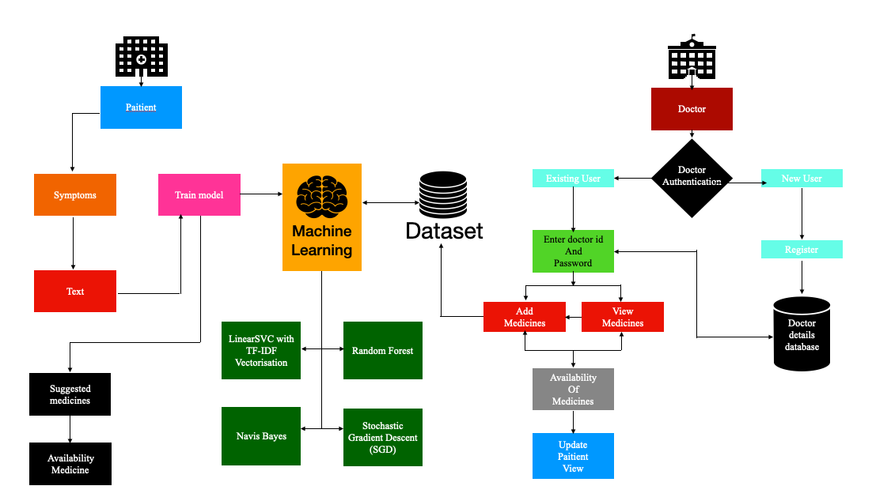
Proposed system architecture

Slide 16
Proposed Methods
Theoretically, this study is based on the fact that the recommended medication should depend on the patient's ability. For example, if the patient has been vaccinated, a reliable drug should be recommended at this time. A risk stratification method has been proposed to determine patient resistance. For example, more than 60 factors, such as blood pressure and alcohol consumption, are used to determine a patient's ability to protect themselves from infection. A web-based model using decision support has also been developed to help physicians choose their first medication. Three different algorithms are examined: decision tree algorithms, support vector machines (SVMs), and backpropagation neural networks that process the data. SVM was chosen as medical recommendation because it performed well on three parameters (model accuracy, model information, model versatility). Error control is also planned to ensure analysis, accuracy and quality control.

Slide 17
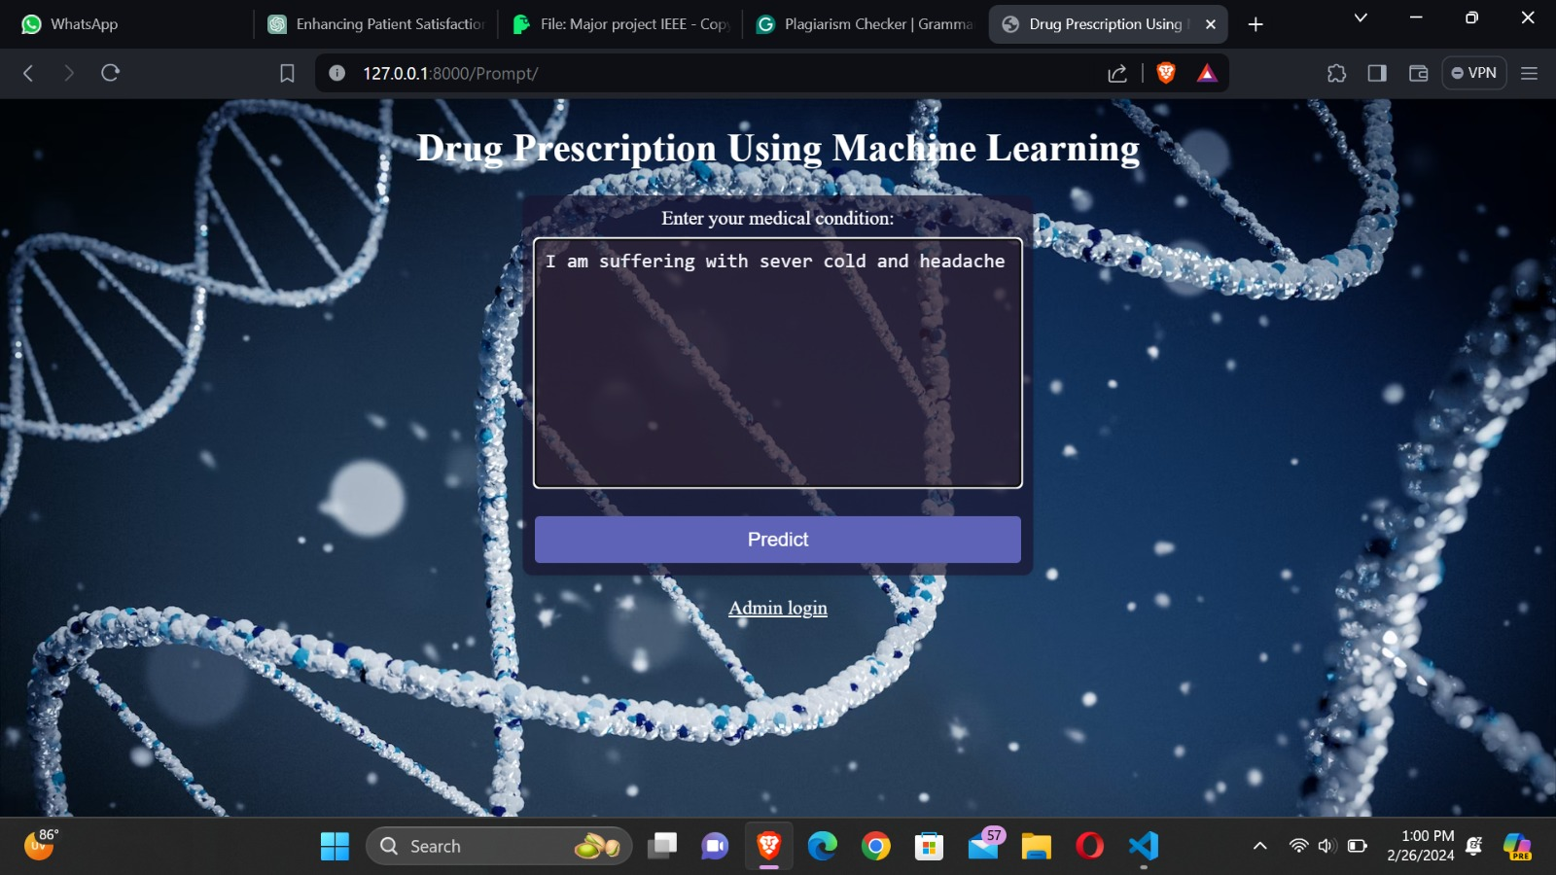
Proposed Methods
User: A portal will be available for users to predict the medicines and the users are the people who want to recommendation from the drug and the data must be in floating mode for the algorithm to execute. We use the recommended medication usage information here.By on clicking on predict we get the appropriate medicine for our input.Accordingly to get to see the information regarding the medicine availability and their status.

Slide 18
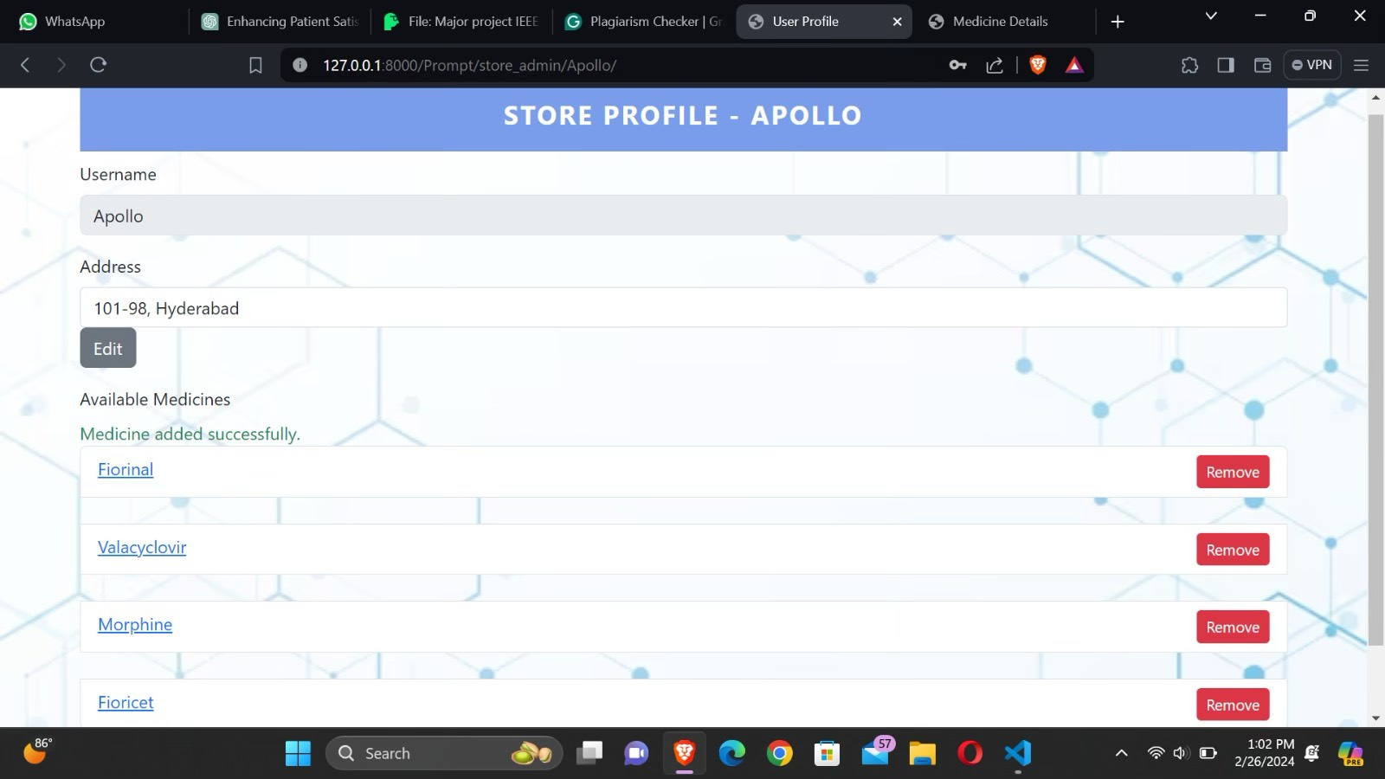
Proposed Methods
Administrator: Administrator of the store manager who can log in using login credentials. Administrators can view the entire profile in the browser. Administrators can click the "Remove" button on the page to see the actual, correct, reverse and F1 scores calculated according to the system. That particular store manager can manipulate data regarding its availability and their location, like wise they get to update the medicine profile in the particular intervals. Once all the algorithms are executed the administrator can see the whole truth of the web page.

Slide 19
Performance Measure:
The presented system is a Django web application designed to facilitate disease prediction based on symptoms provided by patients. Upon receiving a submission through a form, the system processes the symptoms by converting them into a binary vector representation where each element corresponds to a specific symptom. This vector is then fed into a pre-trained machine learning model, likely trained on a dataset associating symptoms with various diseases. The model predicts the most probable disease based on the input symptoms and calculates a confidence score for the prediction using predict_proba(). Additionally, the system recommends a type of doctor for consultation based on the predicted disease, autonomy, and trust in their interactions and transaction.

Slide 20
Performance Measure:
ALGORITHMS | ACCURACY %
Linear SVC(support vector classifier) with TF-IDF vectorization | 90.492%
Stochastic Gradient Descent (SGD) | 93.006%
RANDOM FOREST | 78.004%

Slide 21
Result Analysis
Following the split criterion, the preprocessed data is divided into 60% for training and 40% for testing. Subsequently, the dataset undergoes evaluation using five distinct machine learning classifiers: Decision Tree (DT), Random Forest (RF), Light Gradient Boosting Machine (LGBM), CatBoost, and Naive Bayes (NB). The accuracy of each classifier is computed and presented in the results. The classifier exhibiting the highest accuracy is identified as the optimal choice.

Slide 22
Conclusion
Comments play an essential role in our daily decision-making processes, influencing choices such as online shopping or dining out. To assist in these decisions, we often turn to reviews for guidance. This study employs multiple machine learning classifiers, including logistic regression, perceptron, polynomial naive Bayes, ridge classifier, stochastic gradient descent, linear SVC, Arc reference, TF-IDF, trimmed trees, and random forests, to develop a consensus model.Word2Vec and manual methods are utilized, with LGBM and CatBoost serving as the classifiers for these techniques. Evaluation of these models is conducted using precision, recall, F1-score, accuracy, and AUC score metrics. Results indicate that TF-IDF paired with linear SVC achieves the highest accuracy at 91.5% compared to other models tested. Future research will focus on comparing different methodologies, exploring alternative n-gram approaches, and devising strategies to further enhance recommendation system performance. This study aims to contribute to the advancement of recommendation systems, ultimately aiding users in making informed decisions across various domains.

Slide 23
References
Wittich, C.M., Burkle, C.M., & Lanier, W.L. (2014). Medication errors: An overview for clinicians. Mayo Clinic Proceedings, 89(8), 1116-1125
Chen, M.R., & Wang, H.F. (2013). The reason and prevention of hospital medication errors. Practical Journal of Clinical Medicine
Bartlett, J.G., Dowell, S.F., Mandell, L.A., File, T.M. Jr., Musher, D.M., & Fine, M.J. (2000). Practice guidelines for the management of community-acquired pneumonia in adults. Infectious Diseases Society of America. Clinical Infectious Diseases, 31(2), 347-382. DOI: 10.1086/313954
Fox, Susannah & Duggan, Maeve. (2012). Health Online 2013. Pew Research Internet Project Report.
IRNSS “Signal In Space Interface Control Document for Standard Positioning Service”, version 1.0, ISRO, June 2014.

Slide 24
References
5. G. Bianchi, “Performance analysis of the IEEE 802.11 distributed coordination function,” IEEE J. Sel. Areas Commun., Vol. 18, No. 3, pp. 535–547, Mar. 2000.
6. Venkatesan, K.G.S. "Comparison of CDMA & GSM Mobile Technology." Middle-East Journal of Scientific Research, vol. 13, no. 12, 2013, pp. 1590–1594
7. Priya, P. Indira, and K.G.S. Venkatesan. "Finding the K-Edge connectivity in MANET using DLTRT." International Journal of Applied Engineering Research, vol. 9, no. 22, 2014, pp. 5898–5904.
8. Praveena, Ms. J., and K.G.S. Venkatesan. "Advanced Auto Adaptive edge-detection algorithm for flame monitoring & fire image processing." International Journal of Applied Engineering Research, vol. 9, no. 22, 2014, pp. 5797–5802.

Slide 25
Thank You!

